Slide 1
Improved city maintenance via machine learning
Christian Cleber Masdeval Braz

Slide 2
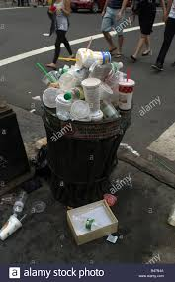
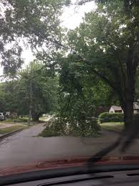

Introduction
City maintenance is challenging and expensive.

Slide 3
Problem
Two main problems:
Where are the issues
What to solve first

Slide 4




Assistance via crowdsourcing
Solving the first part can be assisted by

Slide 5
Common features
Reporting an issue:
Brief description
Long description
Date
Location
Tracking an issue:
Number of votes (proxy for urgency)

Slide 6
Assistance via ML
Crowdsourcing platform alone is not enough.
Make it more effective by allowing immediate ranking of the issues.
As a result, governments can be more efficient, responsive and better fulfill citizens needs.

Slide 7
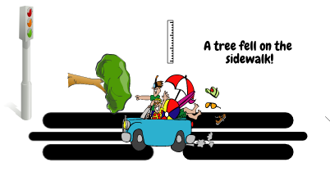
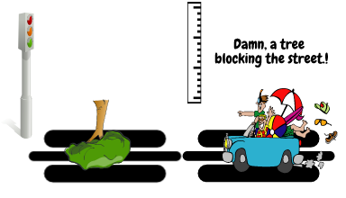
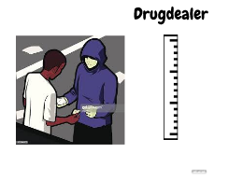
Assistance via ML

Slide 8
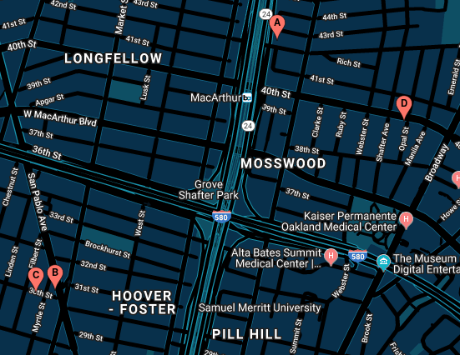
Ranking
Signs: 4 Sidewalk: 5 Trash: 5.68 Graffiti: 7.67 Homeless: 10
Averages
Street Light: 2.86
Signs: 3.24
Sidewalk: 3.27
Trash: 3.54
Graffiti: 3.8
Homeless: 5
Drug: 5.85
Street Light: 12.5
Drug: 8 Sidewalk:10
Drug: 6.5 Pothole: 8

Slide 9
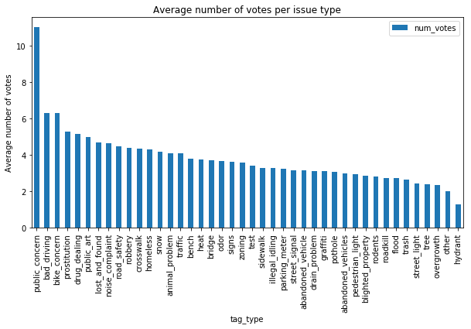
The Dataset

Slide 10
The Dataset
Column | Description | Type | % missing values
summary | Brief description | Text | 0
description | Long description | Text | 52
latitude | Location | Decimal degrees | 0
longitude | Location | Decimal degrees | 0
date | Date and time the issue was reported. | Timestamp | 0
tag_type | Type of issue | Categorical | 76
num_votes | Number of votes collected. | Integer | 0

Slide 11
The Experiment
Models
Baseline
Ridge
SVM
Bi-LSTM
Part A: model fitting using only the textual features.
Part B: model fitting using all features.

Slide 12
The Experiment
Preprocessing:
Prediction and Summary:
Binary BOW representation with 5000 words vocabulary size and pruning words that occur in more than 50% of the documents.
200 dimensional word embedding.
Date: split in hour, day of week, and year. Convert to its one-hot-encoding representation.
Location: round to three decimal places which corresponds to neighborhood precision. One-hot encode.

Slide 13
The Experiment
Algorithm | MSE / R2 Part A | MSE / R2 Part B
Ridge | 0.86 / 0.59 | 0.82 / 0.60
SVM | 0.87 / 0.40 | 0.85 / 0.40
LSTM | 0.82 | 0.65
Baseline MSE: 0.62 Variance votes: 1.52
Data size: 223.120

Slide 14
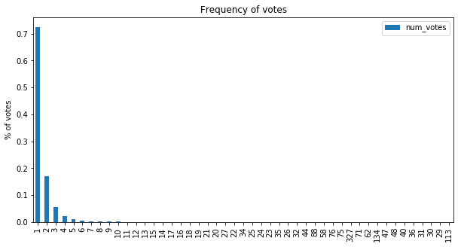
The Experiment

Slide 15
The Experiment
Algorithm | MSE / R2 Part A | MSE / R2 Part B
Ridge | 2.87 / 0.13 | 2.70 / 0.18
SVM | 3.01 / 0.10 | 2.81 / 0.16
LSTM | 2.60 | 2.33
Baseline MSE: 0.83 Variance votes: 3.41
Data size: 53.407 Number of features: (10.000,11.373)

Slide 16
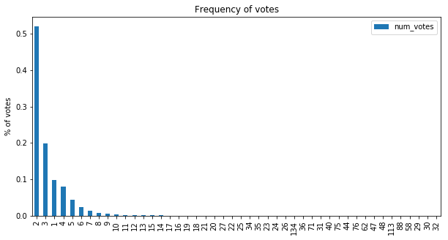
The Experiment

Slide 17
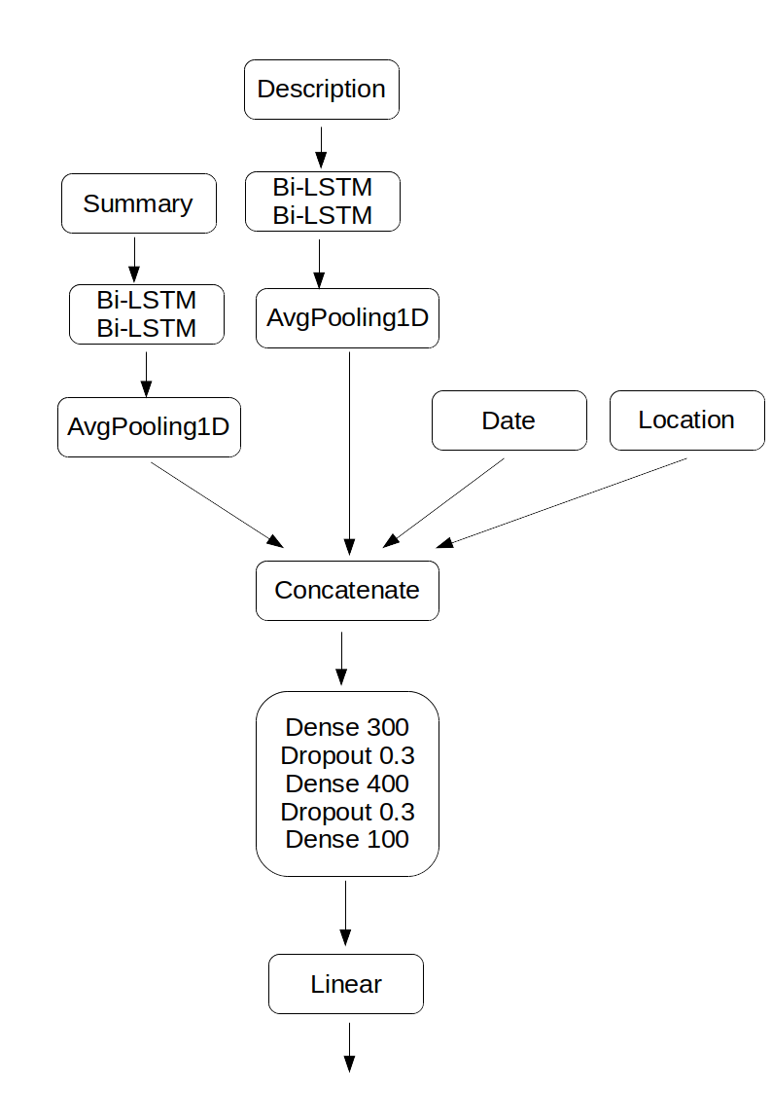
The Experiment

Slide 18
Conclusion
First scenario:
good metrics, but maybe due to the fact that the dataset is biased toward one vote.
inconclusive with respect whether the models are able to high accuracy in a more diverse setting.

Slide 19
Conclusion
Second scenario:
poor relation between number of features and dataset size
a little higher variability and the models suffered
models unable to mimic baseline and detect type given text or come up with another strategy
not enough data points, bad text or both

Slide 20
Conclusion
Models highly depentent on the textual information and its quality.
Regression based on text is hard.
Fine-grained predictions is a distant dream. Would require good textual information and a discriminative variability of number of votes.
Results are inconclusive and maybe an approach
would be to create synthetic data to test
feasibility.

